Slide 1
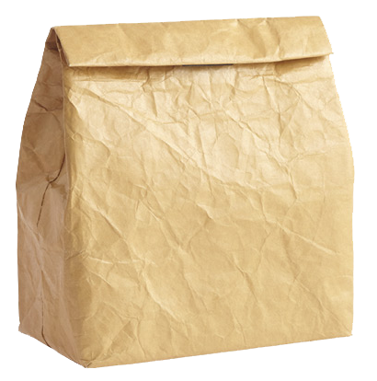
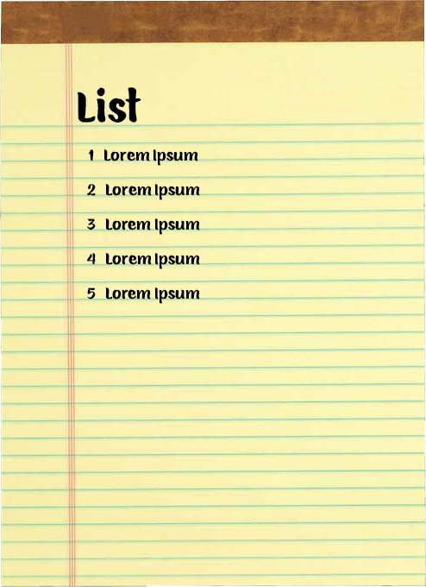
What’s in the bag?
Name:
Purpose: This is an activity to share items important to you.
Time: Unlimited
Materials: Brown paper bag or any bag you have at home
Items around your house
Paper and Pen
Activity Steps:
1. Get a bag.
2. Think about things important to you.
3. Make a list of the five (5) items important to you.
4. Find the item(s) on the list and put them in the bag.
5. Share with the group.
Tammy
PICTURE
MEDAL

